Slide 1
සංඛ්‍යානයේ නිදොස් සහ සදොස්
භාවිතාවන්...
Proper and Improper Applications
in Statistics...
Priyadarshana Dharmawardena
Senior Statistician
Department of Census & Statistics

Slide 2
Overview
Power of Numbers
Summary Measurements
Quantitative Data
Qualitative Data
Misuse of Graphs
Alternative ways of data presentation

Slide 3
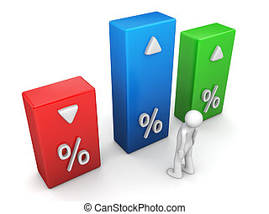
Power of Numbers
Indicators
Estimates
Statistics

Slide 4
Summary Measurements
Why ?
Eg. Marks for Mathematics of Grade 10 students in 2 schools
School A School B
Stud. 1 - 53 Stud. 1 - 80
Stud. 2 - 60 Stud. 2 - 84
Stud. 3 - 67 Stud. 3 - 91
Which
one is
Better?
Considering the figures it can be suggested that students of school B have performed well.
What about a Large amount of data set?…

Slide 5
Summary Measurements Cont…
Analysis depends on the types of data
Two types of data
Quantitative
Measures of central tendency
Measures of Dispersion
Qualitative
Mode
Proportion

Slide 6
Quantitative Data
Measures of central tendency
1. Mean
Sum of the data values
No. of observations
Mean
=
Eg. Mean value of mathematics for each school
School A School B
Mean value = (53+60+67)/3 = 60 (80+84+91)/3 = 85
Students of school B have shown higher mean value
They are cleverer in mathematics than those of school A

Slide 7
Quantitative Data Analysis Cont…
2. Median
Median: Middle value of the data set, after arraigning it in to ascending or descending order
Advantage
Outliers do not affect on the Median
Usually the preferred measure of central tendency when the distribution is not symmetrical
Are mean & median values enough to make
a reasonable conclusion?

Slide 8
Quantitative Data Analysis Cont…
Let See…
Eg. 1 - Suppose Marks for Mathematics in 2 schools
School C School D
Stud. 1 - 53 Stud. 1 - 25
Stud. 2 - 60 Stud. 2 - 60
Stud. 3 - 67 Stud. 3 - 95
Considering the Mean & Median values…
Measurement | School C | School D
Mean | 60 | 60
Median | 60 | 60
Answer
NO…
All values are equal…
Are two schools’ performance are equal?

Slide 9
Quantitative Data Analysis Cont…
Eg. 2 – Let’s consider the batting scores of two Cricketers in 3 matches
Cricketer A Cricketer B
45 100
50 0
55 50
Who will be more
DANGEROUS
to the bowling side???

Slide 10
Quantitative Data Analysis Cont…
Let’s calculate the mean values
Cricketer A = (45 + 50 + 55)/3 = 50
Cricketer B = (100 + 0 + 50)/3 = 50
Measurement | Cricketer A | Cricketer B
Mean | 50 | 50
Median | 50 | 50
Is it fair to say that the both batsmen are
equally dangerous
to the bawling team ? !!!
Answer
NO…

Slide 11
Quantitative Data Analysis Cont…
Just a Mean & Median values are
not enough to make
a reasonable conclusion
◄Very Important ►
Measuring
Variability

Slide 12
Quantitative Data Analysis Cont…
Measurement of Variability
First, familiar with ∑ Notation

Slide 13
Quantitative Data Analysis Cont…
Consider the following numbers
10, 5, 8, 16, 23, 6, 12, 22
Sum
the numbers
starting from first one
Sum the numbers starting from first one to last one
to last one

Slide 14
Quantitative Data Analysis Cont…
n
∑
x_{i}
i=1

Slide 15
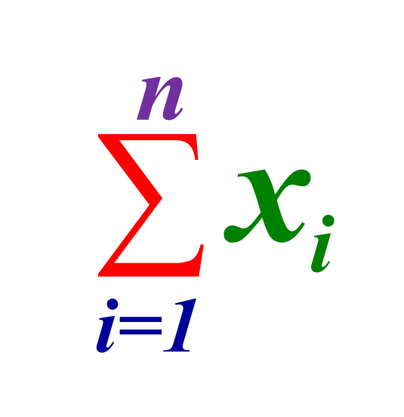
Quantitative Data Analysis Cont…
Sum the numbers
Starting from first one
to last one
= 10 + 5 + 8 + 16 + 23 + 6 + 12 + 22
= 102
In General, let’s consider the following dataset (Variable)
x_{1,} x_{2,} x_{3,} …... x_{i} …... x_{n}
Summation of this n numbers,
= x₁ + x₂ + x₃ +……+ x_{n}

Slide 16
Quantitative Data Analysis Cont…
Variance (σ²)
To measure the spread between numbers in a data set, a relative position is needed
Relative position -> mean
Deviation of any number (x_{i}), from the mean (μ) can be calculated using (x_{i} – μ)
Variance =
Sum of the squares of deviations from the mean
Total number of data

Slide 17
Quantitative Data Analysis Cont…
Variance =
Sum of the squares of deviations from the mean
Total number of data
Variance of the variable; X, (σ²)
Spreading of data → Deviation from μ → σ²
Spreading of data → Deviation from μ → σ²
No Spreading of data → No deviation from μ → σ² = 0

Slide 18
Quantitative Data Analysis Cont…
No Spreading of data → No deviation from μ → σ² = 0
That means, same values in a dataset gives zero variance
6,6,6,6,6,6,6,6,6 → σ² = 0
In a dataset, if all the values are equal, then
Variance = 0

Slide 19
Quantitative Data Analysis Cont…
Measures on Variability
Range
Inter Quartile Range
Mean Deviation
Variance
Standard Deviation
Coefficient of Variation

Slide 20
Qualitative Data
1
Mode = item, which gives the highest frequency
2
(Number of considered “item”)*100
Total No of Items
Proportion (%)
=
Eg.
a,a,b,c,b,b,c,a,a,b,c,c,c,b,a,c,c,c,a,a
Mode = c
Proportion of “a” = 7*100/20 = 35%

Slide 21
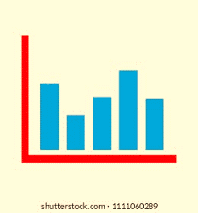
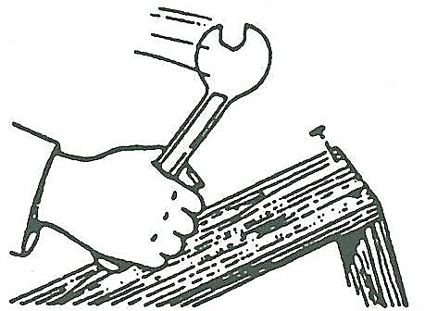
Misuse of Graphs

Slide 22
1. Incorrect Type Eg. a line chart is drawn instead of a bar chart

Slide 23
Incorrect type Cont… Correct Graph

Slide 24
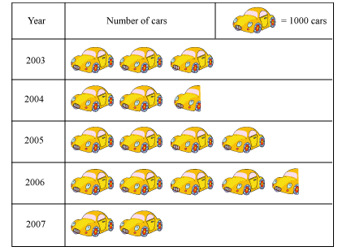
2. Inaccurately drawn Eg. a pictogram where the areas of the pictures are not proportional to data

Slide 25
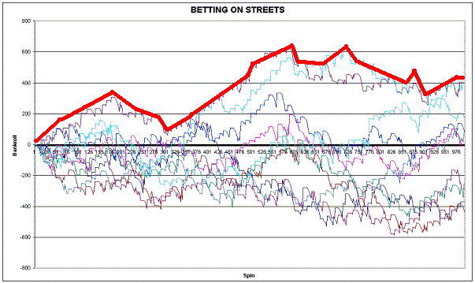
3. Difficult to interpret Eg. Including too much data on one chart

Slide 26
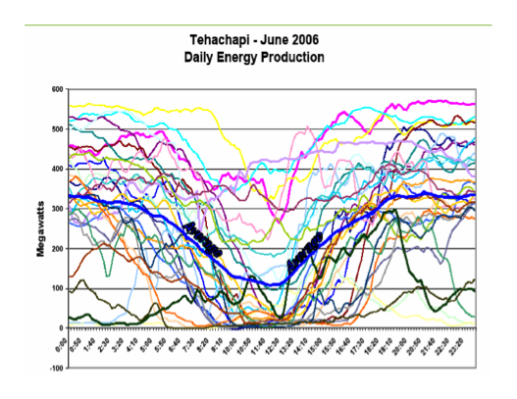
Difficult to interpret Cont…

Slide 27
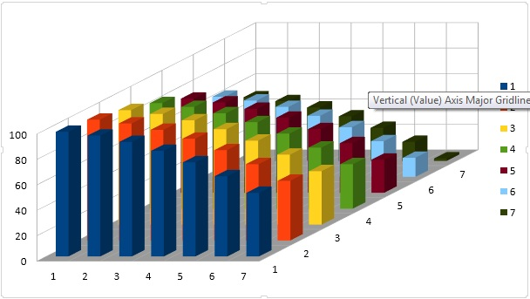
Difficult to interpret Cont…

Slide 28
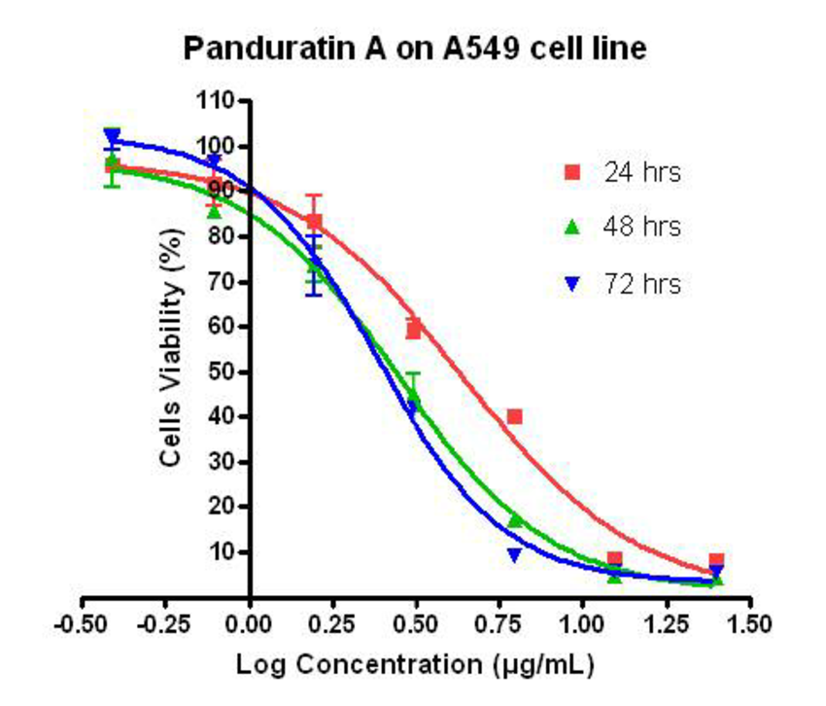
4. Inappropriate to audience Eg. Using a logarithmic scale in a tabloid newspaper article

Slide 29
5. Misleading Eg. Not including the zero point on the y-axis of a bar chart

Slide 30
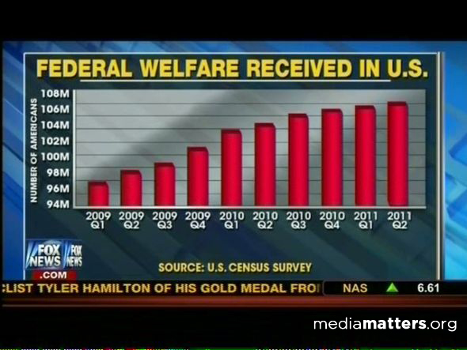
Misleading Cont…

Slide 31
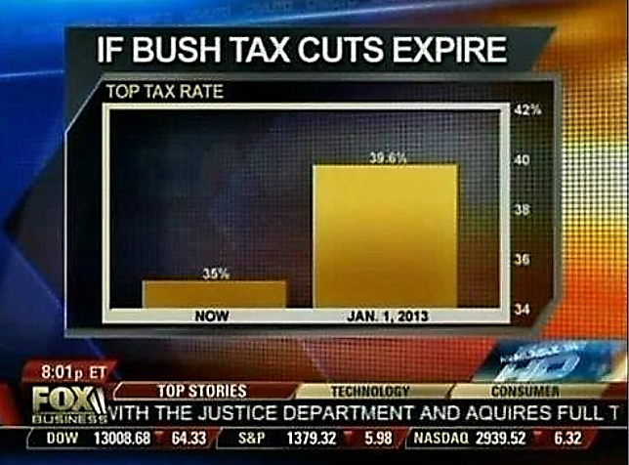
Misleading Cont…
39.6%
4.6%
35%

Slide 32
Relevant authorities of the TV channel apologized for the fault
Misleading Cont…

Slide 33
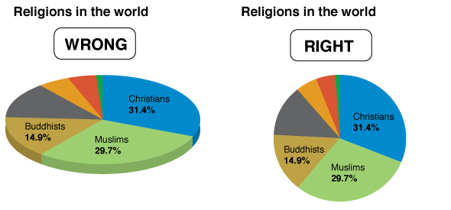
6. Three-dimensional effects Eg. Using a three-dimensional chart when a two-dimensional chart would do

Slide 34
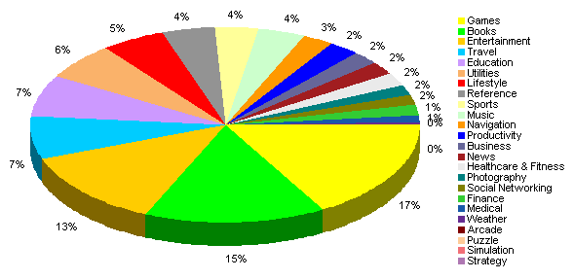
Three-dimensional effects Cont…

Slide 35
Alternative ways of data presentation

Slide 36
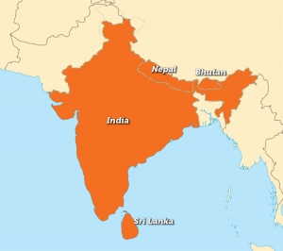
Option 1: Statement comparing the size of an item with a well-known one
Eg.1 - India is 60 times bigger than Sri Lanka

Slide 37
Statement Cont…
Eg.2 - The height of Vitoria dam is 3 times higher than Ceylinco tower

Slide 38
Statement Cont…
Eg.3 - Using the amount of paper used by DCS for the population and housing census in 2001, Sri Lanka can be rapped from point-Devinuwara to Point-Peduru by 6 times

Slide 39
Statement Cont…
The World Factbook — Central Intelligence Agency Website : https://www.cia.gov/library/Publications/the-world-factbook/geos/xx.html

Slide 40
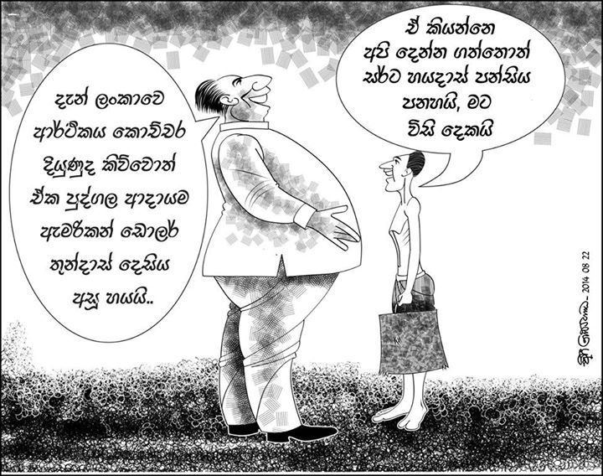
Option 2: Cartoon
Illustrating income disparity using numbers

Slide 41
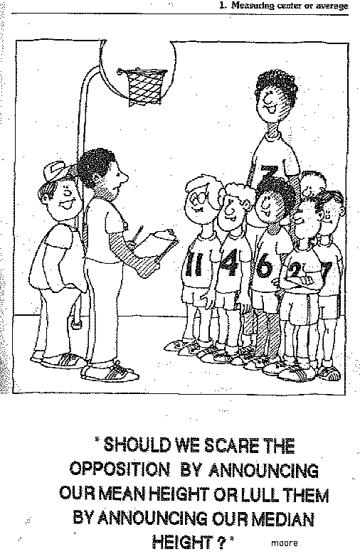
Cartoon Cont…
Comparing relevance of mean and median measurements

Slide 42
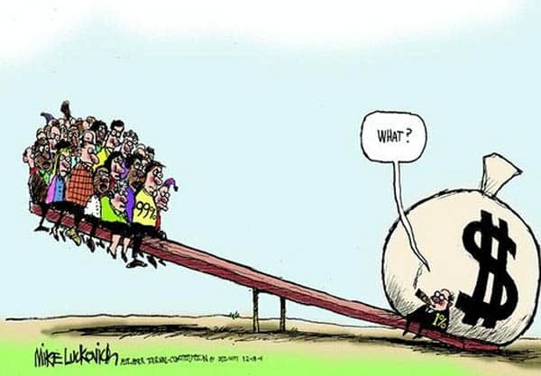
Cartoon Cont…
Illustrating the nature of inequality

Slide 43
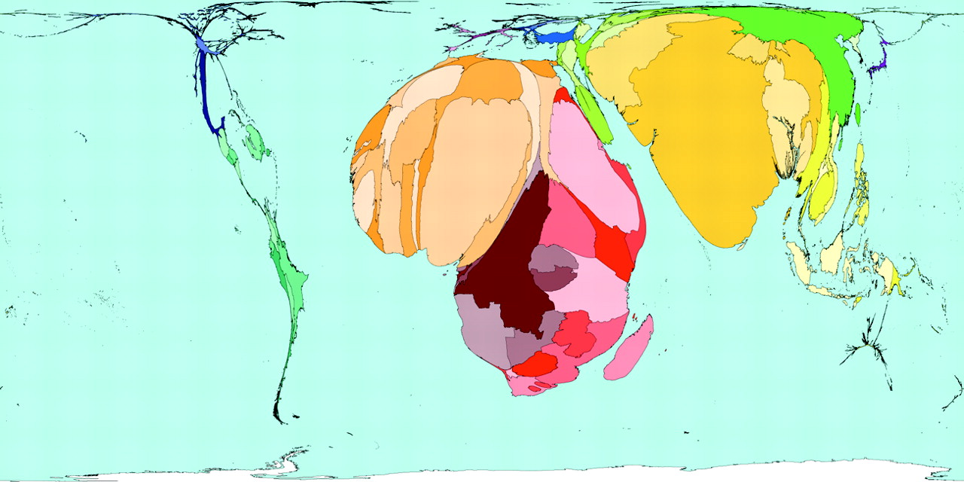
Cartoon Cont…
Comparison of income disparity between all the countries in the globe

Slide 44
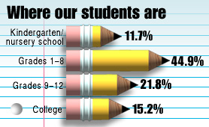
Option 3: Pictures
Graphs using pictures

Slide 45
Pictures
Conventional Graph
Creative display using pictures

Slide 46
Option 4: Posters
Displaying the consequence of global warming

Slide 47
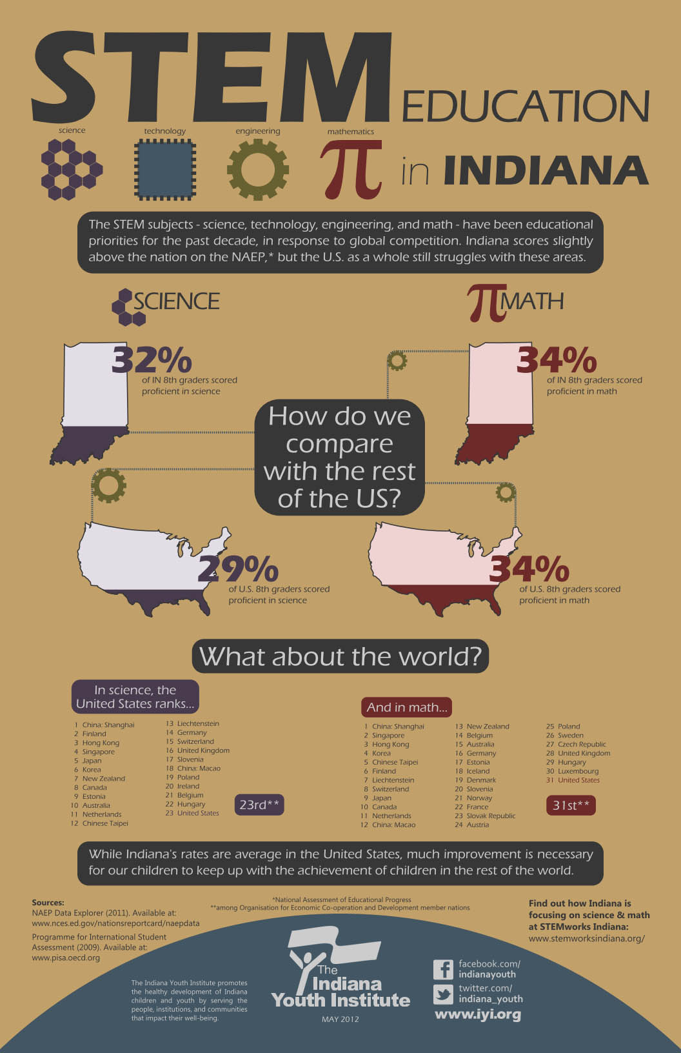
Option 5: Brochures
Comparison of level of education for Maths and Science in Indiana state in USA

Slide 48
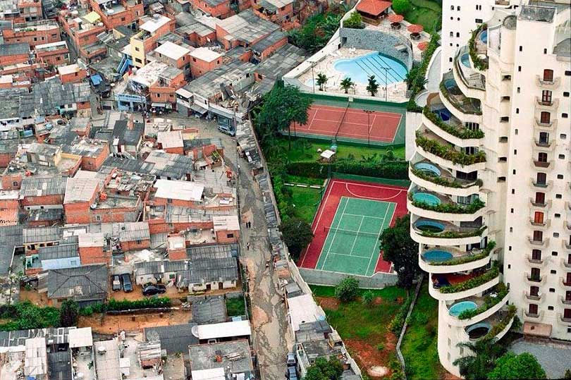
Option 6: Photographs
Displaying the degree of disparity of city dwellers

Slide 49
Thank You

