Slide 1
හොඳ ම දේ දරුවන්ට යි.
Give what is best for the child

Slide 2
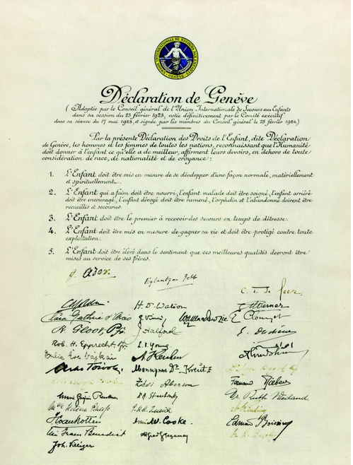
Geneva Declaration of the Rights of the Child
Adopted 2 September, 1924, League of Nations
By the present Declaration of the Rights of the Child, Commonly known as “Declaration of Geneva”, men and women of all nation, recognizing that mankind owes to the Child the that it has to give, declare and accept it has their duty that, beyond and above all considerations of race, nationality or creed:
The Child must be given the means requisite for its normal development, both materially and spiritually;
The Child that is hungry must be fed; the child that is sick must be nursed; the child that is backward must be helped; the delinquent child must be reclaimed; and the orphan and the waif must be sheltered and succoured;
The child must be the first to receive relief in times of stress;
The child must be put in a position to earn a livelihood, and must be protected against every form of exploitation
The child must be brought up in the consciousness that its talents must be devoted to be service of fellowmen.
Notes:
UN was established in 1945 after the WWII. Geneva declaration of the Rights of the Child was initially adopted in 1924 by the League of Nations
1959 Nov 20 UNGA adopted.
The League of Nations was the first worldwide intergovernmental organisation whose principal mission was to maintain world peace.^{[1]} Founded on 10 January 1920 following the Paris Peace Conference that ended the First World War, it ceased operations on 20 April 1946.

Slide 3
Convention on the Rights of the Child (ළමා අයිතිවාසිකම් පිළිබඳ සම්මුතිය) Adopted and opened for signature, ratification and accession by General Assembly resolution 44/25 of 20 November 1989 Entry into force 2 September 1990, in accordance with article 49
Article 1
A child means a every human being below the age of eighteen years
Article 20
A child temporarily or permanently deprived of his or her family environment, or in whose own best interests cannot be allowed to remain in that environment, shall be entitled to special protection and assistance provided by the state.
State parties shall in accordance with their national law ensure alternative care for such a child.
Such care could include, inter alia, foster placement, kafalah of Islamic law, adoption or if necessary placement in suitable institutions for the care of children. When considering solutions, due regard shall be paid to the desirability of continuity in a child’s upbringing and to the child’s ethnic, religious, cultural and linguistic background.
Notes:
54 articles in the convention
According to Article 44 state parties should submit periodic reports – first within 2 years and afterwards every 5 years

Slide 4
“Periodic State Reports” under Article 44 in CRC
Sri Lanka signed the CRC in 1991
Periodic reports
First report 1993 (submitted 1994)
Second report 1998 (submitted 2000)
Third report 2003
Fourth report 2008
Fifth report 2013
Sixth report 2018
(Combined report submitted in 2008)
(Combined report submitted in 2018)

Slide 5
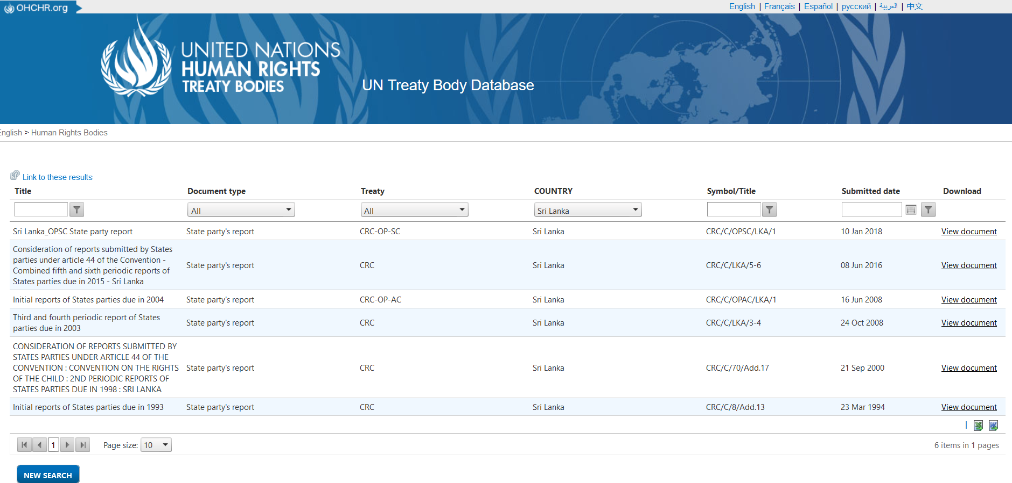
https://tbinternet.ohchr.org/_layouts/15/treatybodyexternal/TBSearch.aspx?Lang=en&TreatyID=5&TreatyID=10&TreatyID=11&DocTypeID=29&DocTypeCategoryID=4
Notes:
Committee on the Rights of the Child give their Concluding observations on each periodic report

Slide 6
Observations of the “Committee on the Rights of the Child” - has a separate para on Data Collection and they continuously comment on the lack of data on children.
Committee on the Rights of the Child (concluding observations for 2nd periodic report of Sri Lanka

Slide 7
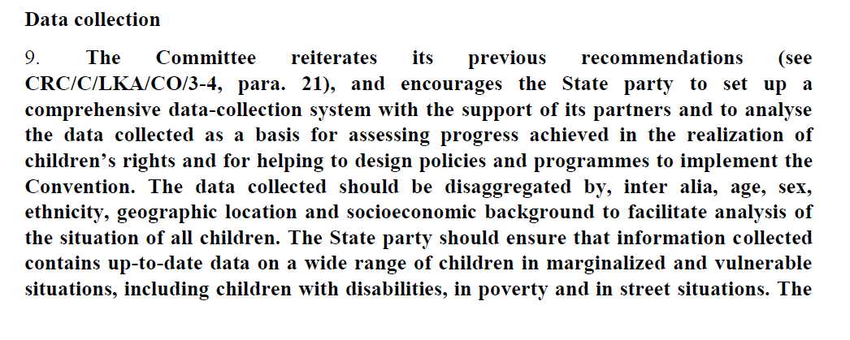
Committee on the Rights of the Child (concluding observations for 3rd/ 4th combined periodic reports of Sri Lanka
Committee on the Rights of the Child (concluding observations for 5th/ 6th combined periodic reports of Sri Lanka

Slide 8
Alternative Care of Children
In 2010, UN General Assembly adopted the resolution “64/152 Guidelines for the Alternative Care of Children” (10 Feb 2010)
The National Alternative Care Policy was approved by the Cabinet in March 2019.

Slide 9
Census of Children in Child Care Institutions 2019

Slide 10
Institutionalization of Children
Children and Young Persons Ordinance
Act no.48 of 1939
(1956 Revision)
Orphanages Ordinance / Child Development Center Charter
Act no.22 of 1941
(1956 Revision)
House of Detention Ordinance
Act no. 5 of 1907
Vagrants Ordinance
Act no. 4 of 1841
Victimized Children
Child suspects
Child offenders
Orphaned Children
Abandoned Children
Destitute Children

Slide 11
Steps in the Census Process
Listing of Child Care Institutions
Development of the Census Schedule
Planning the field activities
Enumeration
Data processing

Slide 12
Census Questionnaires
CC4
CC2
CC3
CC1

Slide 13
Number of Child Care Institutions and Number of Children
Number of Institutions 414
Number of children 14,179
2019
Number of institutions 379
Number of children 10,632
2013*
*Departments of Probation and Child Care Services

Slide 14
Information on Child Care Institutions

Slide 15
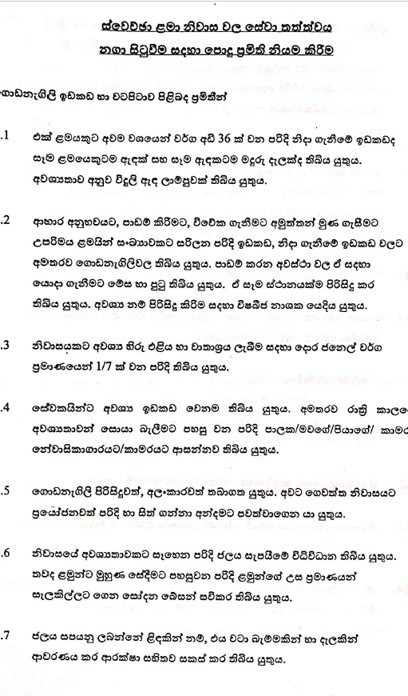
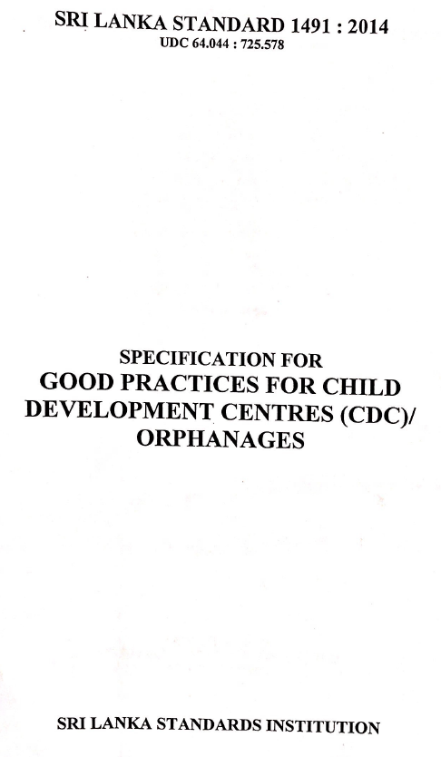

Slide 16
Table 1: Child Care Institutions by type of institution
Type of Institution | Number of institutions | %
Remand home | 14 | 3.7
Safe house | 4 | 1.1
Certified school | 9 | 2.4
Approved school | 1 | 0.3
State receiving home | 9 | 2.4
Detention home | 1 | 0.3
Training and counseling center | 4 | 1.1
Voluntary children home | 331 | 87.3
Other* | 6 | 1.6
Total | 379 | 100
*Child development centers temporarily functioned under
provincial departments of Probation and Child Care Services

Slide 17
Table 2: Number of Child Care Institutions by province
Province | Number of institutions
Western | 121
Central | 38
Southern | 31
Northern | 41
Eastern | 61
North-western | 36
Central | 38
North -central | 15
Uva | 17
Sabaragamuwa | 19
Total | 379

Slide 18
Figure 1: Number of Child Care Institutions by district

Slide 19
Figure 2: Child Care Institutions by source of funding

Slide 20
Table 3: Child Care Institutions by major source of funding and type of institution
Source of funding and type of institution | Number of institutions
Government funds | 47
Remand home | 14
Safe house | 4
Certified school | 9
State receiving home | 9
Detention home | 1
Training and counseling center | 4
Other * | 6
Non-government - local funds | 229
Voluntary children home | 229
Non-government - foreign funds | 92
Voluntary children home | 92
Other source of funding | 11
Voluntary children home | 10
Approved school | 1
Total | 379
*Child development centers temporarily functioned under provincial departments of Probation and Child Care Services
Note: Although most institutions receive from multiple sources, major source has been considered here

Slide 21
Figure 3: Child care Institutions by number of children currently accommodated

Slide 22
Table 4: Child care Institutions by number of children currently accommodated
Type of institution | Total | 0-19 | 20-39 | 40-59 | 60-79 | 80-99 | 100-149 | 150 and more
Remand home | 14 | 10 | 3 | - | 1 | - | - | -
Safe house | 4 | 3 | 1 | - | - | - | - | -
Certified school | 9 | 2 | 2 | 4 | 1 | - | - | -
Approved school | 1 | - | - | - | - | - | 1 | -
State receiving home | 9 | 1 | 7 | - | 1 | - | - | -
Detention home | 1 | - | - | - | - | 1 | - | -
Training and counseling center | 4 | 3 | 1 | - | - | - | - | -
Voluntary children home | 331 | 130 | 146 | 33 | 5 | 8 | 7 | 2
Other* | 6 | 1 | 4 | 1 | - | - | - | -
Total | 379 | 150 | 164 | 38 | 8 | 9 | 8 | 2
*Child development centers temporarily functioned under provincial departments of Probation and Child Care Services

Slide 23
Table 5: Child Care Institutions accommodating excess number of children by type of institution
Type of Institution | Total number of institutions | Accommodating excess no. of children
 |  | No. of institutions | %
Remand home | 14 | 3 | 21.4
Safe house | 4 | - | -
Certified school | 9 | 1 | 11.1
Approved school | 1 | - | -
State receiving home | 9 | 2 | 22.2
Detention home | 1 | 1 | 100.0
Training and counseling center | 4 | 1 | 25.0
Voluntary children home | 331 | 22 | 6.6
Other* | 6 | 3 | 50.0
Total | 379 | 33 | 8.7
*Child development centers temporarily functioned under provincial departments of Probation and Child Care Services

Slide 24
Table 6: Child Care Institutions by education related facilities/ services provided
Facilities/ services provided | Number of institutions | %
Provision of non-formal education facilities for non-school going children of school age
Provided both within and outside the institution | 7 | 1.8
Provided only within the institution | 34 | 9.0
Provided only outside the institution | 2 | 0.5
Not Provided | 111 | 29.3
Not relevant* | 225 | 59.4
Participation of school going children in additional tuition classes
Participate both within and outside the institution | 136 | 35.9
Participate only within the institution | 162 | 42.7
Participate only outside the institution | 20 | 5.3
Not participated | 21 | 5.5
No school going children | 40 | 10.6
Total | 379 | 100
*Includes institutions with no children of school going age or/ and institute where all children are attending school

Slide 25
Cont.….. Table 6: Child Care Institutions by education related facilities/ services provided
Facilities/ services provided | Number of institutions | %
Participation of children in vocational training courses
Participate both within and outside the institution | 14 | 3.7
Participate only within the institution | 62 | 16.4
Participate only outside the institution | 19 | 5.0
Not participated | 249 | 65.7
No eligible children for vocational training | 35 | 9.2
Total | 379 | 100
*Includes institutions with no children of school going age or/ and institute where all children are attending school

Slide 26
Table 7: Child Care Institutions by health-related facilities/ services provided
Facilities/ services provided | Number of institutions | %
Provision of health facilities for children
Provided both within and outside the institution by a qualified doctor/ doctors | 196 | 51.7
Provided only outside the institution by a qualified doctor/ doctors | 183 | 48.3
Participation of children for counseling programs
participate both within and outside the institution | 118 | 31.1
participate only within the institution | 161 | 42.5
participate only outside the institution | 24 | 6.3
Not participated | 76 | 20.1
Total | 379 | 100

Slide 27
Table 8: Child Care Institutions by special program conducted for children during 2019
Type of program | Number of institutions | %
Sports meet | 187 | 49.3
Excursions/ trips | 248 | 65.4
Going to movies/ dramas (outside the premises) | 118 | 31.1
Religious program | 316 | 83.4
New year festival | 50 | 13.2
World Children's Day celebration | 55 | 14.5
Concerts | 18 | 4.7
Music/ Drama program | 16 | 4.2
Aesthetic appreciation program | 12 | 3.2
Physical exercise program | 11 | 2.9
Other Programs | 76 | 20.1
Not conducted any special program | 19 | 5.0
Total number of institutions | 379 | -
Note: Total does not tally as most of institutions have conducted more than one special program

Slide 28
Table 9: Child Care Institutions with library facilities and additional reading materials
Type of Institution | Total number of institutions | With library facilities within the institution | Papers/magazines purchased for children's use
 |  |  | Daily | At least Weekly | Only monthly | Once in a while | Not purchased
Remand home | 14 | 14 | 6 | 4 | - | - | 4
Safe house | 4 | 4 | 1 | 1 | - | - | 2
Certified school | 9 | 7 | 2 | 1 | - | - | 6
Approved school | 1 | 1 | 1 | - | - | - | -
State receiving home | 9 | 3 | - | - | 1 | 1 | 7
Detention home | 1 | 1 | 1 | - | - | - | -
Training and counseling center | 4 | 3 | 2 | - | - | - | 2
Voluntary children home | 331 | 310 | 129 | 116 | 20 | 7 | 59
Other* | 6 | 6 | 1 | 2 | - | - | 3
Total | 379 | 349 | 143 | 124 | 21 | 8 | 83
*Child development centers temporarily functioned under provincial departments of Probation and Child Care Services

Slide 29
Table 10: Child Care Institutions by currently accommodated children per toilet ratio
Availability of toilets | Number | %
A toilet per child | 18 | 4.7
A toilet for 2 children | 61 | 16.1
A toilet for 3 - 4 children | 170 | 44.9
A toilet for 5 - 6 children | 90 | 23.7
A toilet for 7 - 8 children | 21 | 5.5
A toilet for 9 - 10 children | 6 | 1.6
A toilet for 11 - 20 children | 7 | 1.8
A toilet for more than 20 children | 1 | 0.3
Number of toilets not specified | 2 | 0.5
No children currently accommodated | 3 | 0.8
Total | 379 | 100

Slide 30
Table 11: Child Care Institutions by adequacy of beds for children
Reserved beds | Number of institutions | %
Each child has an own bed | 59 | 15.6
Sufficient beds are not available for its children | 28 | 7.4
Excess beds available | 280 | 73.8
Number of beds are not specified | 12 | 3.2
Total | 379 | 100

Slide 31
Table 12: Child Care Institutions by facilities provided for children
Facility | Number of institutions | %
Reserves lecture halls/ class rooms /libraries for children's education | 353 | 93.1
Reserves halls/ rooms for the fitness activities of children | 90 | 23.7
Provides indoor sport facilities for children | 104 | 27.4
Provides outdoor playground for children | 201 | 53.0
Provides children park/ kid's play areas for children | 200 | 52.8
Total number of institutions | 379 | -
Note: Total does not tally as each facility is considered separately for each institution

Slide 32
Table 13: Number of Institutions which conduct placement committee/ warrant committee/ case committee meetings by type of institution
Type of Institution | Total number of institutions | Number of institutions conducted committee meetings
Remand home | 14 | 5
Safe house | 4 | 2
Certified school | 9 | 6
Approved school | 1 | 1
State receiving home | 9 | 8
Detention home | 1 | 1
Training and counseling center | 4 | 1
Voluntary children home | 331 | 306
Other* | 6 | 4
Total | 379 | 334
*Child development centers temporarily functioned under provincial departments of Probation and Child Care Services

Slide 33
Table 14: Child Care Institutions which conducted committee meetings during 2019 by number of meetings held
Number of meetings held | Number of institutions | %
One meeting | 89 | 26.6
Two meetings | 91 | 27.2
Three meetings | 71 | 21.3
Four meetings | 15 | 4.5
Five or more | 48 | 14.4
No meetings held in 2019 | 15 | 4.5
Not specified | 5 | 1.5
Total | 334 | 100

Slide 34
Employees of Child Care Institutions

Slide 35
Table 15: Number of employees in Child Care Institutions by type of institution
Type of institution | Total
Remand home | 116
Safe house | 19
Certified school | 134
Approved school | 12
State receiving home | 203
Detention home | 27
Training and counseling center | 37
Voluntary children home | 2,273
Other* | 53
Total | 2,874
*Child development centers temporarily functioned under provincial departments of Probation and Child Care Services

Slide 36
Table 16: Employees in Child Care Institutions by service period
Service period | Number | %
Service in the current institution
less than 1 year | 695 | 24.2
1 -4 years | 997 | 34.7
5-9 years | 528 | 18.4
10 or more years | 530 | 18.4
Not specified | 124 | 4.3
Service in the current occupation
less than 1 year | 607 | 21.1
1-4 years | 923 | 32.1
5-9 years | 612 | 21.3
10 or more years | 613 | 21.3
Not specified | 119 | 4.1
Total | 2,874 | 100

Slide 37
Table 17: Employees in Child Care Institutions by nature of the appointment and sex
Nature of the appointment | Total |  | Male |  | Female
 | Number | % | Number | % | Number | %
Permanent | 1,824 | 63.3 | 636 | 65.6 | 1,188 | 62.4
Temporary/Casual | 698 | 24.3 | 193 | 19.9 | 505 | 26.5
Contract basis | 206 | 7.1 | 92 | 9.5 | 114 | 6.0
Other | 129 | 4.5 | 41 | 4.2 | 88 | 4.6
Unspecified | 17 | 0.8 | 7 | 0.7 | 10 | 0.5
Total | 2,874 | 100 | 969 | 100 | 1,905 | 100

Slide 38
Table 18: Employees in Child Care Institutions by nature of the employment and sex
Nature of Employment | Total |  | Male |  | Female
 | Number | % | Number | % | Number | %
Whether residential/ non residential
Residential | 1,508 | 52.5 | 431 | 44.5 | 1,077 | 56.5
Non Residential | 1,253 | 43.6 | 485 | 50.1 | 768 | 40.3
Not specified | 113 | 3.9 | 53 | 5.5 | 60 | 3.1
Whether shift work/ daily duties
Shift Work | 525 | 18.3 | 193 | 19.9 | 332 | 17.4
Daily Duties | 1,729 | 60.2 | 551 | 56.9 | 1,178 | 61.8
Not specified | 620 | 21.6 | 225 | 23.2 | 395 | 20.7
Total | 2,874 | 100 | 969 | 100 | 1,905 | 100

Slide 39
Figure 4: Employees in Child Care Institutions by highest level of education

Slide 40
Table 19: Employees in Child Care Institutions by highest level of education & sex
Highest level of education | Total |  | Male |  | Female
 | Number | % | Number | % | Number | %
Never Attended School | 41 | 1.4 | 8 | 0.8 | 33 | 1.7
Passed grade 1-5 | 193 | 6.7 | 75 | 7.7 | 118 | 6.2
Passed grade 6-10 | 547 | 19.0 | 199 | 20.5 | 348 | 18.3
Passed G.C.E. O/L | 748 | 26.0 | 252 | 26.0 | 496 | 26.0
Passed G.C.E. A/L | 1,019 | 35.5 | 275 | 28.4 | 744 | 39.1
Degree & Above | 298 | 10.4 | 146 | 15.1 | 152 | 8.0
Not specified | 28 | 1.0 | 14 | 1.4 | 14 | 0.7
Total | 2,874 | 100 | 969 | 100 | 1,905 | 100

Slide 41
Basic information
Institutionalization
Education and literacy
Parents and guardians
Siblings
Deinstitutionalization
Children in Child care Institutions

Slide 42
Number of children in Child care Institutions
10,632

Slide 43
Children by sex
Male
4,017 (37.8%)
Female
6,615 (62.2%)

Slide 44
Number of children by district

Slide 45
Number of children by the year institutionalized

Slide 46
Number of children by registration of birth
Total children
10,632
Birth registered
9,606 (90.4%)
Birth certificate
9,266 (96.5%)
Probable age certificate (අනුමාන වයස් සහතිකය),
329 (3.4%)
Birth not registered
531 (5.0%)
Not known
493 (4.6%)

Slide 47
Whether the mother is a minor at child birth (ළමයා උපදින විට මව බාල වයස් කාරියක්ද?)
Yes, 898 (8.4%)
Whether the child born out of wedlock (ළමයා අවිවාහක මවකට දාව උපන්නේ ද?)
Yes 1,031 (12.1%)
No 8,324 (78.3%)
No, 8,639 (81.3%)
Not known, 1,095 (10.3%)
Not known 1,007 (9.5%)
Number of children by nature of the birth

Slide 48
Number of children by place resided when institutionalized
Place resided | Number of Children | %
House belonged to mother/ father/ guardian or an inherited house | 7,124 | 67.0
House not belonged to mother/ father/ guardian | 1,980 | 18.6
Pavement | 337 | 3.2
Hospital | 184 | 1.7
Religious place | 74 | 0.7
Child Care Institution/ Other Protection Center | 388 | 3.6
Other | 83 | 0.8
Not known | 438 | 4.1
Not specified | 24 | 0.2
Total | 10,632 | 100

Slide 49
Number of children by person lived with at the time of institutionalization

Slide 50
Number of children by reason for the institutionalization

Slide 51
A normal behaviour (90%)
Has attacked other children/ has attempted to do so
Tends to get isolated/ Prefers isolation
Frequent scolding of staff and children harshly
Other
Has attempted to runaway
Show hyper sexual/ homosexual drive
Has inflicted self- injuries (cutting) or has attempted to do so
Has attacked the staff/ has attempted to do so
Has attempted suicide
9,545
Behavioural patterns observed from children in the institution
51
91
104
131
144
10,632
231
251
297
441

Slide 52
Education of children
Children aged 3 years and over 10,386
Engaged in education activity 9,658 (93%)
Not engaged in education activity, 728 (7%)

Slide 53
Literacy among children (6 years and over)
18 and above
96.4
15-17
95.9
11-14
90.6
8-10
6-7
Both sexes
93.7
Male
92.0
Female
94.7
94.6
76.9

Slide 54
Guardianship of the child
At the time of institutionalization
Current
1,562
Mother/ father/ both parents were guardians 7,102 ( 66.8%)
Mother/ father/ both parents are guardians
6,946 (65.3%)

Slide 55
Father’s background characteristics at the time of institutionalization
6,824
Marital status
Where resided
Economic status
Health status

Slide 56
Mother’s background characteristics at the time of institutionalization
8,872
Marital status
Where resided
Economic status
Health status

Slide 57
Children who were under a guardian at the time of institutionalization
Type of residence of guardian
1,968
Relationship to the guardian
Relationship | Number | %
Grandmother | 954 | 48.5
Aunt | 388 | 19.7
Brother/ Sister | 141 | 7.2
Grandfather | 139 | 7.1
Non relative | 134 | 6.8
Uncle | 113 | 5.7
Other relation | 61 | 3.1
Relationship not specified | 25 | 1.3
Stepfather/ stepmother | 13 | 0.7
Total | 1,968 | 100

Slide 58
Frequency of visiting
Father
6,738
(63.4%)
Mother
8,824
(83.0%)
Other guardian
1,829
(17.2%)
Current guardian of the child and frequency of they visiting the child
Not specified
Never visited
Only once so far
Once every few years
Several times a year
About once a month
Several times a month

Slide 59
Presence of siblings
Have siblings
8,015 (75.4%)
No siblings
1,707 (16.0%)
Not known
904 (8.5%)
Not specified
6 (0.1%)

Slide 60
Living place of siblings
Place of residence | Number | %
All siblings in this institution | 1,411 | 17.6
All siblings in other institutions | 715 | 8.9
All siblings living in this institution and other institution | 273 | 3.4
All siblings living elsewhere | 50 | 0.6
At least one sibling living in this institution and/or other institution | 869 | 10.8
All siblings living with mother/ father/ guardian | 2,927 | 36.5
All siblings living in this institution and Mother/father/ guardian | 870 | 10.9
None of the siblings in institutions | 202 | 2.5
Whereabouts of all siblings are not known | 689 | 8.6
Not specified | 9 | 0.1
Total | 8,015 | 100
2,449 (30%)

Slide 61
Total children 10,632
Yes
2,133 (20.1%)
No
7,259 (68.3%)
Not relevant
1,219 (11.5%)
Not specified
21 (0.2)
Whether efforts been made at any time to reintegrate the child into the society
Efforts been made
Handover the child back to the mother/ father
Handover the child to a relative/ fit person
Place the child for local adoption
Place the child for foreign adoption
Direct the child to an in-service training
Direct the child to an employment/ self-employment
Enter the child into marriage

Slide 62
Total children 10,632
Yes
2,133 (20.1%)
No
7,259 (68.3%)
Not relevant
1,219 (11.5%)
Not specified
21 (0.2)
Whether efforts been made at any time to reintegrate the child into the society
Reason for not attempting
The time period approved/ ordered for institutionalization has not ended (17%)
A sufficient time period has not passed since the institutionalization to initiate the reintegration process.(14%)
searching for information about the mother and father (4%)
Consent of the mother/ father/ guardian has not been given (21%)
Health issues of the child (1%)
Health issues of the mother/ father/ guardian (2%)
Legal barriers (10%)
Administrative reasons (4%)
This institution being the safest place for the child (40%)
Child still in education (4%)
No one to take on the child (1%)

Slide 63
Foreign/ local adoption (කුලවැද්දීම)
By sex and age group
Children who are currently placed for foreign/ local adoption is 174

Slide 64
Children who have been placed for foreign/ local adoption by actions taken/ being taken in relation to the
adoption
Children who haven't been placed for foreign/ local adoption by reason
1,928
174
Reason | Number
Disapproval of the father/ mother/ guardian | 953
Child not being eligible for an adoption | 329
Yet to receive the consent of the father/ mother/ guardian | 249
Order for the adoption of the child has not been issued by the court | 76
Processing to handover the child to mother/ father/ relative/ non relative | 38
Failure of previous attempts for adoption of the child | 22
Child exceeded the adoption age | 19
Health issues of the child | 8
Other reasons | 6
Not specified | 15
Action | Number
Obtained the consent/affidavits of the mother/ father/ guardian | 53
Obtained recommendations for the adoption from the Placement Committee/ Adoption Committee | 75
Obtained the court order for the adoption | 49
Entered the name into the Adoption Register | 62
Publicized the name for the adoption | 30
Identified a suitable applicant for adoption | 40
Filed the adoption case/ the case is in progress | 24

Slide 65
Policy Interventions

Slide 66
Interventions recommended
All government and private Child Care Institutions are effectively regulated and monitored.
Probation and Child Care Services come under the devolved government. National Child Protection Authority (NCPA) has mandatory powers under Act No.50 of 1998 to monitor Child Care should be strengthened.
Increasing the funding allocated for Probation and Child Care Services by respective Provincial Councils
UN Committee on the Rights of the child frequently comments on the lack of qualified staff, lack of training and inadequate monitoring and supervision

Slide 67
Interventions recommended
Implement proper system for providing counselling, psychosocial support, arranging home visits by social workers to provide guidance for vulnerable families.
92% of the children in institutions have one or both parents alive at the time of institutionalization. Most families are trapped in poverty, surviving on irregular income or suffering other major obstacles in caring for their children.
Reintegration plans are established for each individual child and a central authority to monitor and follow up on their well-being even after they have left the institution
Some children fall prey to sex and drug exploitation after leaving institutions

Slide 68
Interventions recommended
Implementation of the Alternative Care Policy
development of high-quality alternative care options such as kinship care, fostering and national adoption (reforming the current care system, retraining care and social work staff, reallocating the care budget, recruiting family-based carers and appointment.)
Update existing policies and laws
Most of the extremely importance policies and laws are stagnant for a long time in one place without moving forward.

Slide 69
Interventions recommended
Youth Justice through a Restorative Justice System
When a child (above 12) is accused of offence, according to the current systems in place, the child is treated like an adult who has committed a crime.
Restorative rehabilitative system instead of Retributive criminal justice

Slide 71
Conducted by:
Research and Special Studies Division
Department of Census and Statistics
25 October 2021

